Slide 1


Slide 2
Cloud Computing
And Now For Something Completely Different

Slide 3
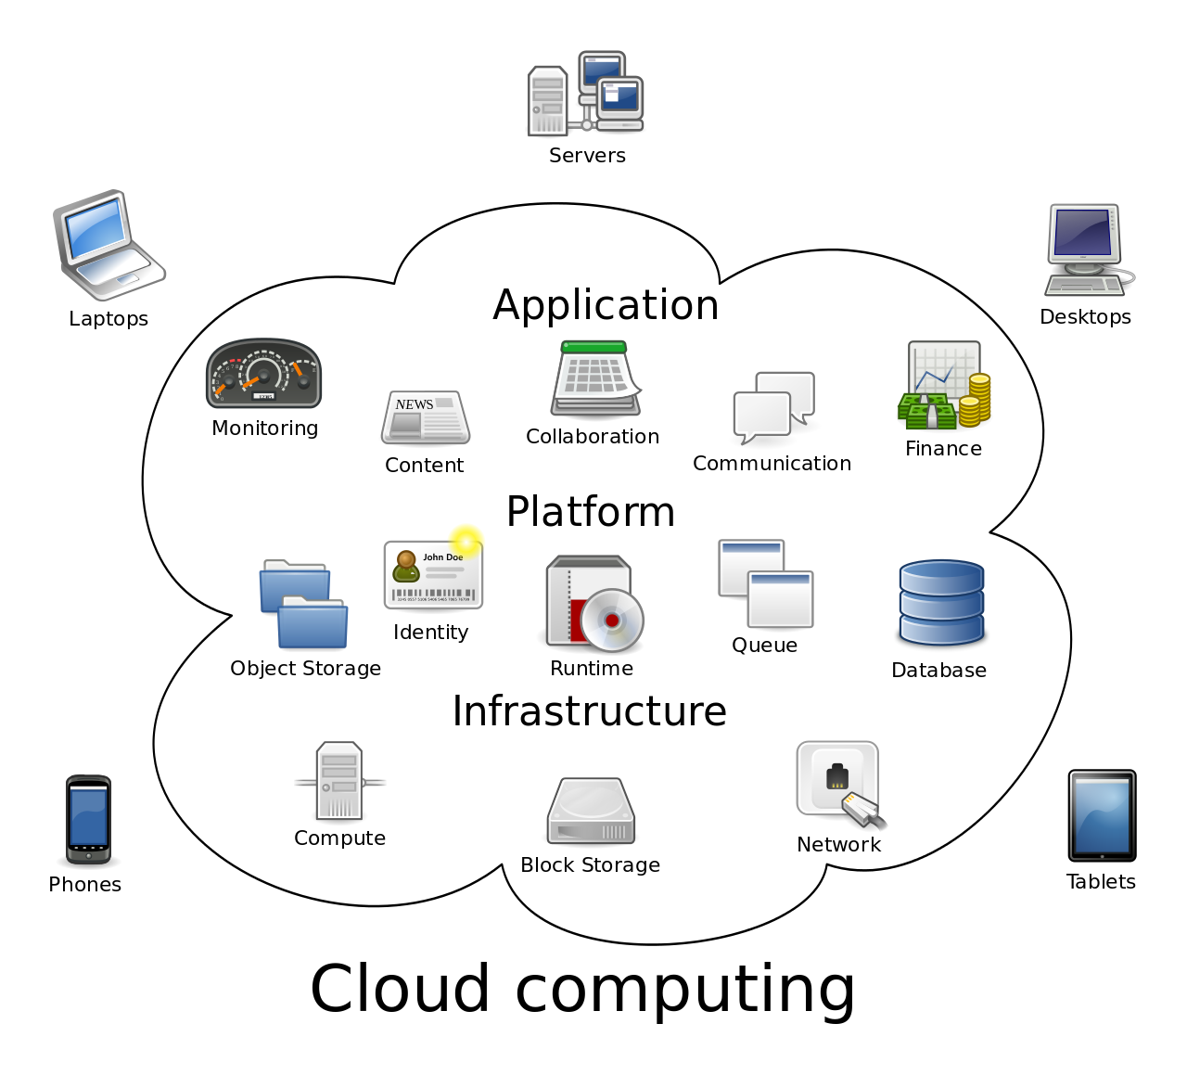
Cloud Computing
We’ve been slowly moving up the abstraction hierarchy:
Started with transistors
Assembly/Machine Code
C
Java/VM
Networking
Now we hit the highest level of abstraction: The Cloud
Notes:
Can be found online… but I can’t link to it

Slide 4
Cloud Computing
“The Cloud” is so abstract it is sometimes hard to even understand what it means
Unfortunately the term has been taken by marketing and turned into a buzzword
Notes:
Can be found online… but I can’t link to it

Slide 5
Cloud Computing
“Cloud computing is the on-demand availability of computer system resources, especially data storage (cloud storage) and computing power, without direct active management by the user.”
Notes:
Can be found online… but I can’t link to it

Slide 6
Cloud Computing
In plain english: the cloud is:
A bunch of computers working together
Tied together via network connections
Usually easily scalable (add another server, worker, etc either automatically or via a simple interface)
Typically managed, at the hardware level, by someone else
E.g. amazon
Notes:
Can be found online… but I can’t link to it

Slide 7
Cloud Computing
Typically, although not always, these servers are
Located in a data center
Virtualized (multiple server instances per physical server)
Have a very fast local network backbone for inter-cloud communication
Have very fast connections to the internet
Notes:
Can be found online… but I can’t link to it

Slide 8

History
2006 - Amazon.com released the Elastic Compute Cloud (EC2)
2008 - Google App Engine
2010 - Microsoft Azure
2010 - Rackspace OpenStack
2011 - IBM SmartCloud
Notes:
Can be found online… but I can’t link to it

Slide 9
Characteristics
EC2 is the largest cloud platform
What does it provide?
Scalable servers (easy to add or remove)
A web GUI and API for adding and removing them
Automated Scaling
Monitoring
Persistent Storage APIs
Notes:
Can be found online… but I can’t link to it

Slide 10
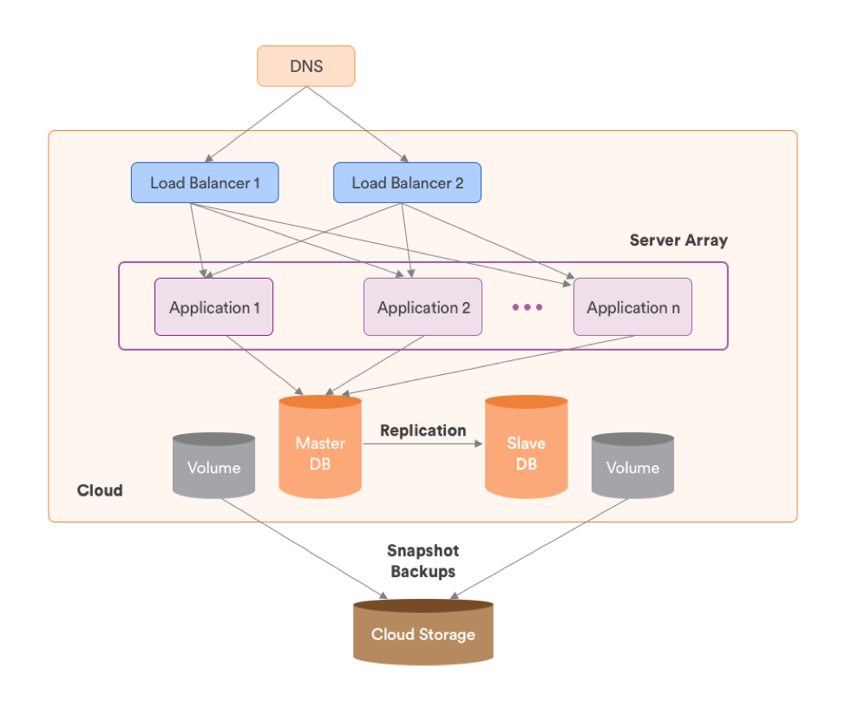
Architecture
At right is a very basic cloud architecture
DNS - Domain Name System
Load Balancers
Application Servers
Databases
Cloud Storage
Notes:
Can be found online… but I can’t link to it

Slide 11
Architecture
DNS
Originated in ARAPANET
Maps a name (e.g. monata.edu) to an IP address (e.g. 153.90.3.95)
Initially consisted of a single HOST.TXT file at Stanford Research
1980s - turned into a network protocol for resolving
Notes:
Can be found online… but I can’t link to it

Slide 12
Architecture
Load Balancer
Balances network requests between various application servers
Typically a relatively simple (and therefore reliable) server
May detect bad application servers and route away from them
Providing failover support in your cloud system
Notes:
Can be found online… but I can’t link to it

Slide 13
Architecture
Load Balancer
Load balancers may be session aware, to route a user to the same application server (if possible)
Why?
Load balancers may provide filtering or other services as well
gzip compression
firewall support
Notes:
Can be found online… but I can’t link to it

Slide 14
Architecture
Application Servers
Where the application logic lives
E.g. a search node that is responsible for taking a search query and turning it into an HTML response
May be Node, a J2EE server, a PHP server, .NET, etc.
Notes:
Can be found online… but I can’t link to it

Slide 15
Architecture
Databases
Where the persistent data for an application is stored
RDBMs
Mongo
Etc.
This diagram shows a replication set
A replication set is part of clustering, which we will talk about later in the class
Notes:
Can be found online… but I can’t link to it

Slide 16
Architecture
Cloud Storage
Stores data and files related to the application
Why not use the DB?
DBs tend to perform poorly when delivering binary data, or even text data, compared with a file system
Notes:
Can be found online… but I can’t link to it

Slide 17
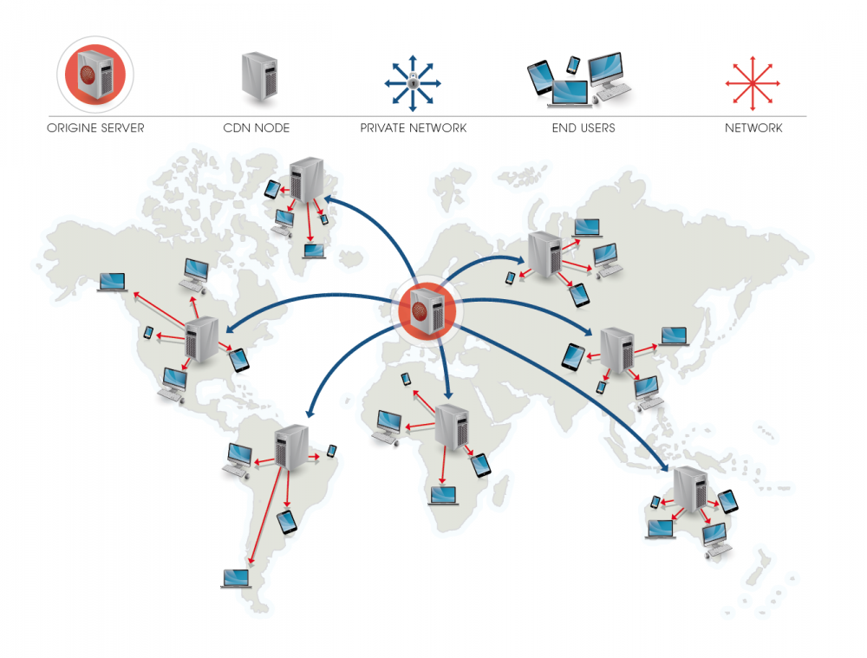
CDNs
A CDN is a Content Delivery Network
A system for delivering static content efficiently
Static content - content that doesn’t change
Typically sits in front of your load balancer
Notes:
Can be found online… but I can’t link to it

Slide 18
CDNs
An origin server is the source of content (typically your cloud storage solution)
Assets (e.g. images) are resolved through the CDN and the request is routed to the closest physical CDN node
After initial request from the CDN node to the origin, no more requests
Notes:
Can be found online… but I can’t link to it

Slide 19
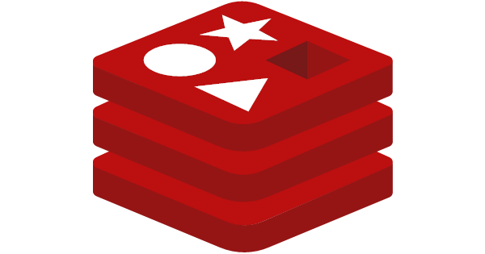
Redis
Redis is a very popular data store frequently used in cloud architectures
Provides simple but powerful functionality:
Lists
Sets
Maps
Locks
etc.
Notes:
Can be found online… but I can’t link to it

Slide 20
Redis
Redis is typically used as a cache layer
Alongside your Database
Not between your Database and application layer
The 440 project has a good, basic example how Redis would be deployed in a cloud architecture
Notes:
Can be found online… but I can’t link to it

Slide 21
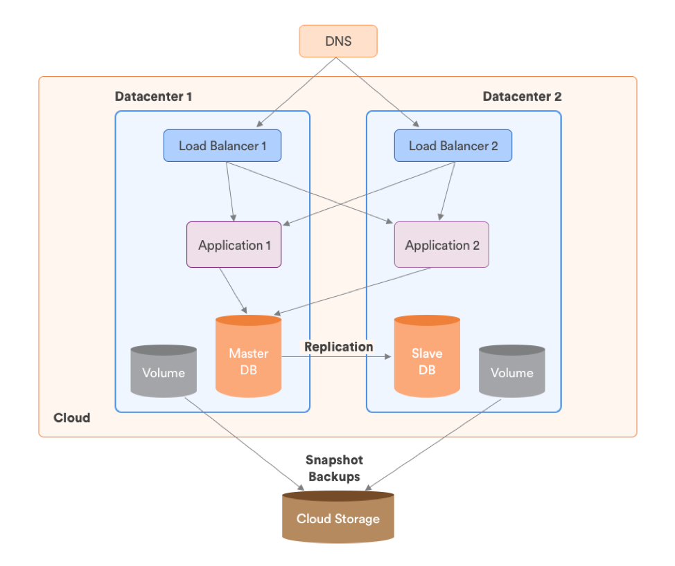
Multi-Datacenter Clouds
In order to survive major outages, a cloud may be split across multiple data centers
When this is done, you must decide on your data layout
1 master DB?
Replication between peer databases?
Notes:
Can be found online… but I can’t link to it

Slide 22
Cloud Computing
How does cloud computing match up with the computer system?
Load Balancer → CPU control logic (?)
Application Server → CPU
RDMBS → Memory/Disk
Redis → Cache
Storage → Disk
Network → Bus
Notes:
Can be found online… but I can’t link to it

Slide 23
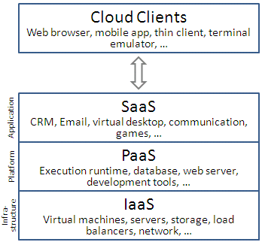
Developing On Cloud
Various terms have come to be used when discussing software deployed in a Cloud
XaaS
SaaS - Software as a Service
PaaS - Platform as a Service
IaaS - Infrastructure as a Service
Notes:
Can be found online… but I can’t link to it

Slide 24
Developing On Cloud
SaaS - The highest level software deployed in a Cloud system
Provides a full software solution
Gmail
D2L
etc.
Notes:
Can be found online… but I can’t link to it

Slide 25
Developing On Cloud
PaaS - Offers a full platform for developers to work with
.NET on Azure is a good example
AWS offers Elastic Beanstalk
Takes care of a lot of configuration for you
Heroku is another excellent example that we will use for our project
Notes:
Can be found online… but I can’t link to it

Slide 26
Developing On Cloud
IaaS - Offers a network abstraction over a particular piece of infrastructure
Most of AWS is IaaS
It gives you building blocks, not an entire platform
A good example would be an email delivery provider
Notes:
Can be found online… but I can’t link to it

Slide 27
Developing On Cloud
Cloud Computing has definitely gone to the industries head
FaaS - Functions as a service
Individually deployed functions in a cloud
Sometimes called “serverless” because there isn’t a… server? Wait, of course there is…
Notes:
Can be found online… but I can’t link to it

Slide 28
Developing On Cloud
“Serverless” really means “you don’t run or pay for a server”
Amazon Lambda is a good example
Also related to the idea of “microservices”
Small individual network services that do one thing
Notes:
Can be found online… but I can’t link to it

Slide 29

Microservices
“grug wonder why big brain take hardest problem, factoring system correctly, and introduce network call too
seem very confusing to grug”
https://grugbrain.dev/#grug-on-microservices
Notes:
Can be found online… but I can’t link to it

Slide 30
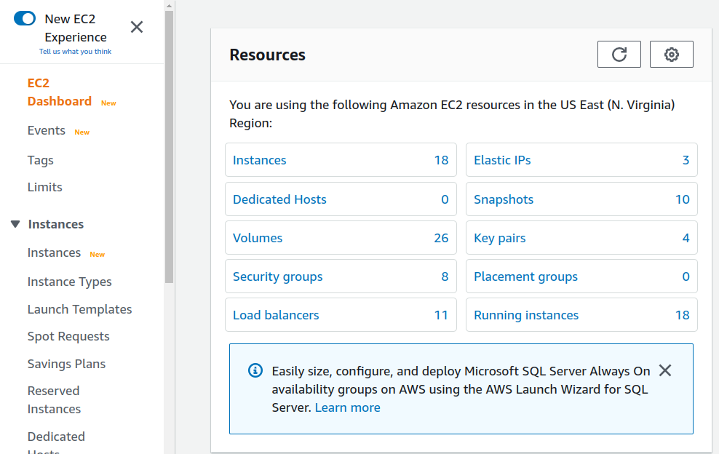
Cloud == Amazon
One of the hard things about cloud computing is that there aren’t good standards
Kubernetes, a cloud-management system from Google, is changing this to an extent
Unfortunately, today, when people say “cloud” they usually mean AWS
Notes:
Can be found online… but I can’t link to it

Slide 31
AWS
AWS stands for Amazon Web Services
A cloud hosting environment by amazon that provides various services
Virtual servers
Load balancers
CDNs (explained in a bit)
Storage
Extremely popular
Notes:
Can be found online… but I can’t link to it

Slide 32
AWS
AWS stands for Amazon Web Services
A cloud hosting environment by amazon that provides various services
Virtual servers
Load balancers
CDNs (explained in a bit)
Storage
Extremely popular
Notes:
Can be found online… but I can’t link to it

Slide 33
AWS
I’m not a fan of AWS
Confusing UI, lots of amazon-specific jargon
But it is the standard
As a career move, getting some AWS certifications would be a good idea
Still, I hate AWS
Notes:
Can be found online… but I can’t link to it

Slide 34
AWS
LeadDyno, my old startup, used AWS
Here is a screenshot of some of the resources it used
Two big ones:
EC2 (Servers)
Server Nodes
Web nodes
Worker nodes
Load Balancers
S3 (Storage)
Buckets
Notes:
Can be found online… but I can’t link to it

Slide 35
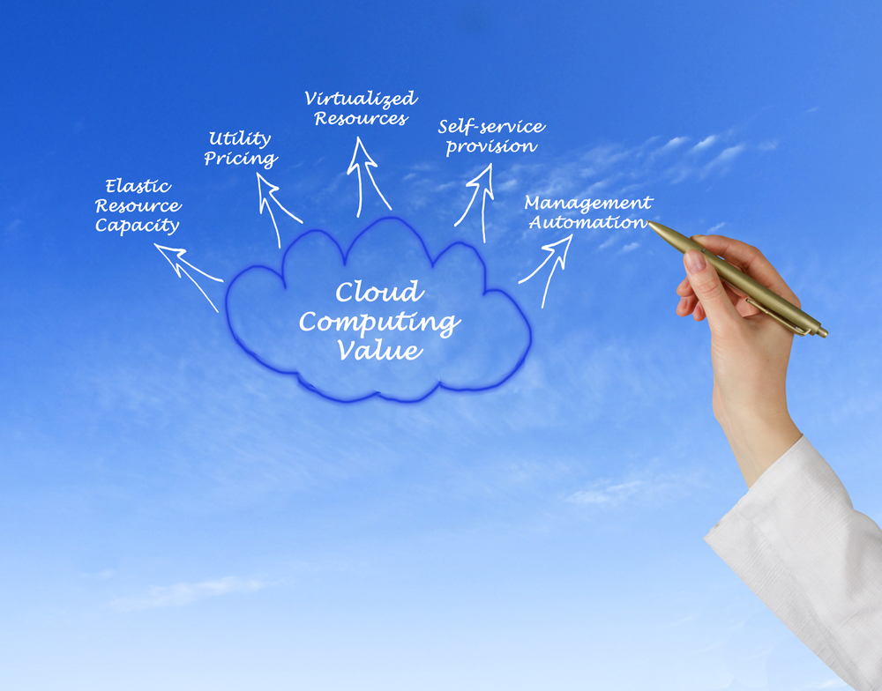
Cloud Computing Advantages
Unfortunately the cloud computing industry has been loaded with buzzwords from the start
However, it is worth understanding some of these terms when discussing advantages of Cloud Computing
Notes:
Can be found online… but I can’t link to it

Slide 36
Cloud Computing Buzzwords
Elastic Resource Capacity - Cloud systems have the ability to increase or reduce resources according to load
Utility Pricing - pay as you go models (can be expensive during spikes!)
Notes:
Can be found online… but I can’t link to it

Slide 37
Cloud Computing Buzzwords
Virtualized Resources - By running multiple virtual instances on one physical system, you can multiplex resource needs (CPU) over multiple workloads
Just hope you don’t get stuck on a server running a bitcoin miner
Notes:
Can be found online… but I can’t link to it

Slide 38
Cloud Computing Buzzwords
Self-service provision: you can spin up your own new instances via a console, you don’t have to call someone to walk down and physically install a new server on a rack
Like when dinosaurs roamed the earth
Notes:
Can be found online… but I can’t link to it

Slide 39
Cloud Computing Buzzwords
Management Automation - Unfortunately this does not mean that Management has been replaced with competent AI. Instead it means that you can automate your server management (e.g. autoscaling)
Notes:
Can be found online… but I can’t link to it

Slide 40
Cloud Computing
Cloud computing is a network-centric deployment model for software
Often leverages virtualization to put multiple servers on a single physical device
Characterized by flexibility in
Provisioning new servers
Scaling resource needs up and down
Amazon/AWS is the biggest cloud platform
The cheapest place to run AWS servers is in Virginia
Why is that?

